Slide 1
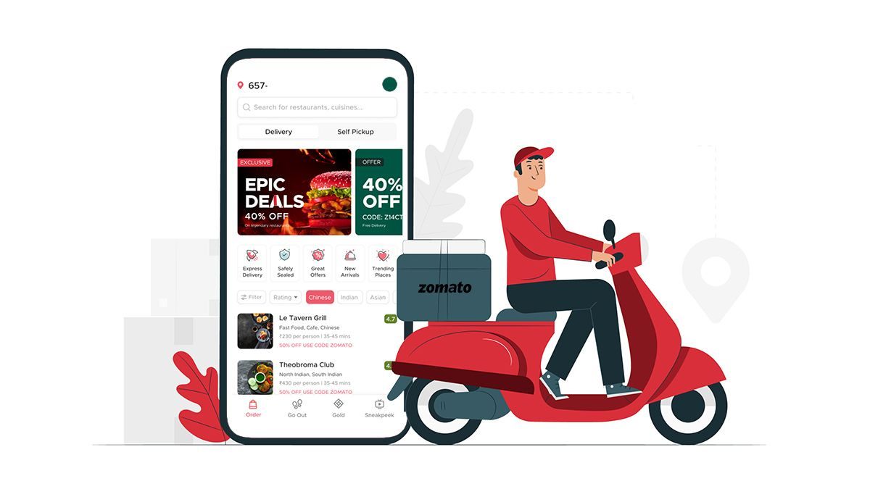
Zomato Sales Analysis
Data analysis using python

Slide 2

Introduction
Zomato is a popular online platform that connects users with a wide variety of restaurants, providing details such as menu options, customer reviews, ratings, and more. As a global leader in the food service industry, Zomato's vast dataset offers valuable insights into restaurant types, customer behavior, and trends across different regions. By analyzing this data, businesses can make data-driven decisions to improve customer satisfaction, optimize their service offerings, and enhance overall performance.
In this project, we explore a Zomato dataset containing information about various restaurant types, customer votes, and other key factors. The goal is to analyze this data and extract meaningful insights that can be used to address business questions, identify trends, and support decision-making processes.

Slide 3

Tools Used
Excel
Python
Data Visualization
Libraries
Pandas
Numpy
Matplotlib
SeaBorn

Slide 4

Problem Statements
Our analysis focuses on understanding customer voting patterns based on different restaurant types. We aim to answer the following questions……..

Slide 5
Introduction: Python Libraries for Data Analysis
Python has become a leading programming language for data analysis due to its simplicity and the wide range of powerful libraries it offers. These libraries provide tools for handling, analyzing, and visualizing large datasets efficiently. In this project, we utilize several essential Python libraries to perform data analysis on the Zomato dataset, each serving a unique purpose in the data processing and visualization pipeline.
Pandas Pandas is the cornerstone of data manipulation in Python. It provides two key data structures: Series and DataFrames, which allow users to store, manipulate, and analyze structured data.
NumPy stands for Numerical Python and is used for numerical computations. It provides support for large multi-dimensional arrays and matrices, along with a collection of mathematical functions to operate on these arrays. While Pandas is often preferred for data manipulation, NumPy underlies many operations and enhances performance.

Slide 6
Matplotlib is a versatile library for creating static, animated, and interactive visualizations. It is widely used for producing line plots, bar charts, scatter plots, and more. Its flexibility allows for precise customization of visual elements, making it a preferred choice for creating publication-quality figures.
Seaborn is built on top of Matplotlib and provides a higher-level interface for creating more aesthetically pleasing and informative statistical graphics. Seaborn specializes in making complex visualizations easy to implement and beautiful by default, including heatmaps, violin plots, and pair plots.

Slide 7
Conclusion
Each of these libraries plays a crucial role in the data analysis process, enabling us to clean, manipulate, and visualize data effectively. By leveraging Pandas, NumPy, Matplotlib, Seaborn, SciPy, and Plotly, we can extract meaningful insights from complex datasets, such as the Zomato dataset, and present the results in a clear and impactful manner. These tools collectively form the foundation for efficient and robust data analysis in Python.

Slide 8
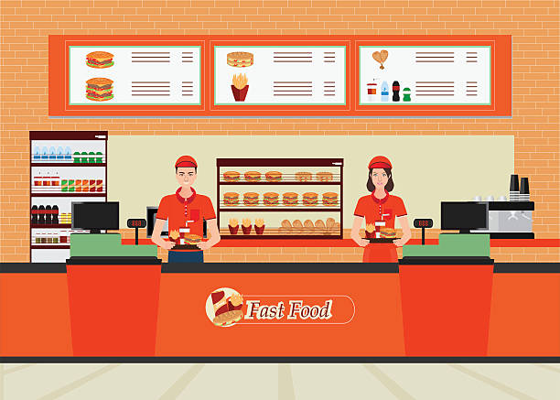
Problem Statements-1
1. What type of restaurant do the majority of customers order from?

Slide 9
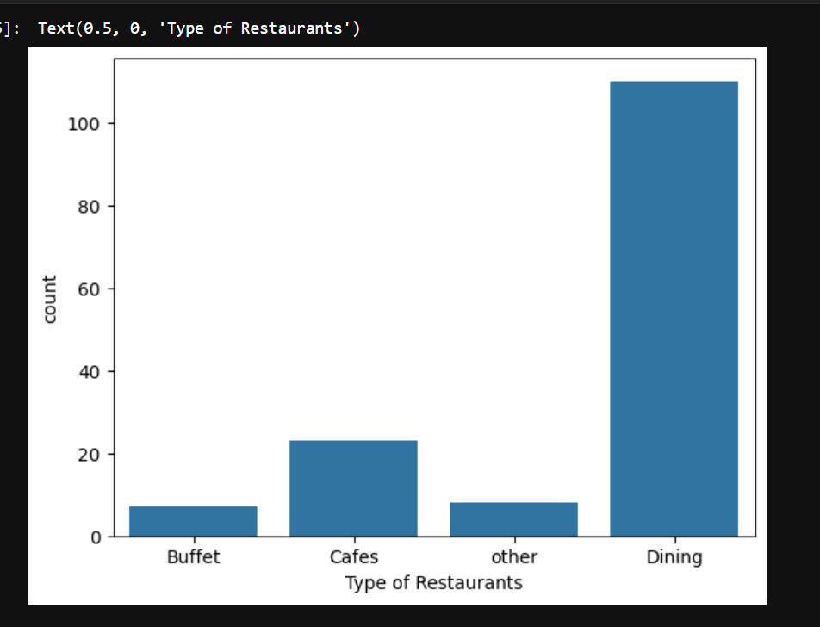
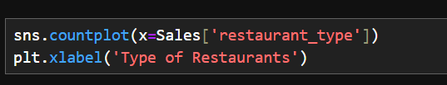
Solution
Conclusion: Majority of the customers prefer Dining Type of Restaurants

Slide 10

Problem Statements-2
2.How many votes has each type of restaurant received from customers?

Slide 11
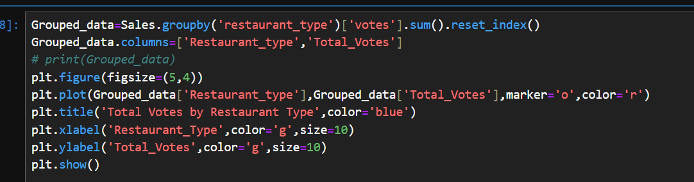
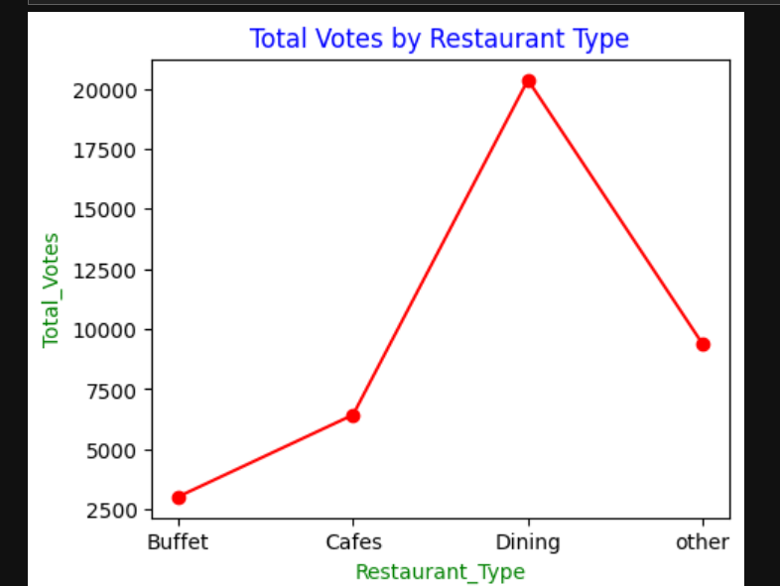
Solution
Conclusion: Dining Restaurant type has max number of votes

Slide 12

Problem Statements-3
3.What are the ratings that the majority of restaurants have received?

Slide 13
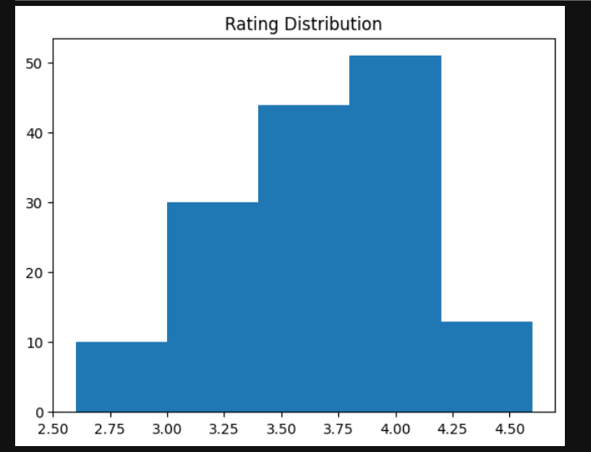
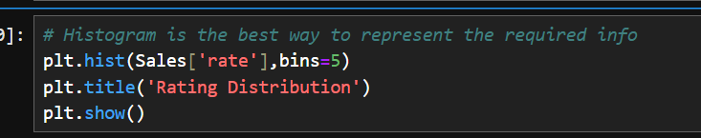
Solution
Conclusion: The Majority of restaurants receive ratings from 3.5 to 4.0

Slide 14

Problem Statements-4
Zomato has observed that most couples order most of their food online.
What is their average spending on each order?

Slide 15
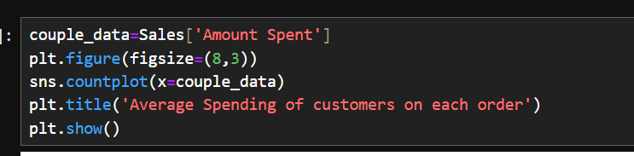
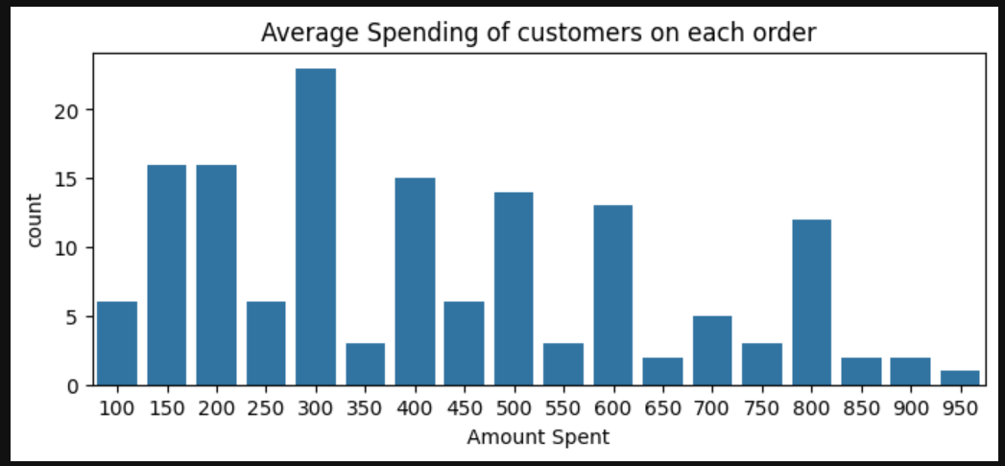
Solution
Conclusion: The majority of couples prefer restaurants with an approximate cost of 300 rupees

Slide 16

Problem Statements-5
5. Which mode(online or Offline) has received the maximum rating?

Slide 17
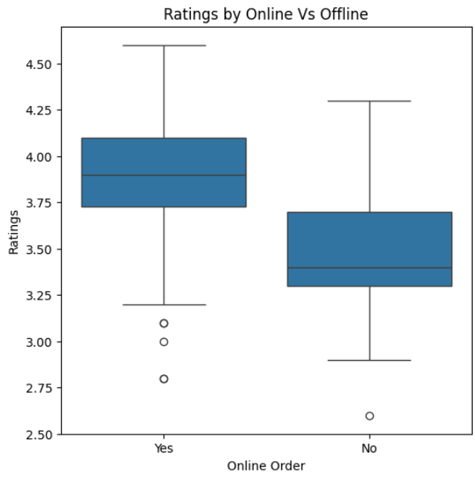
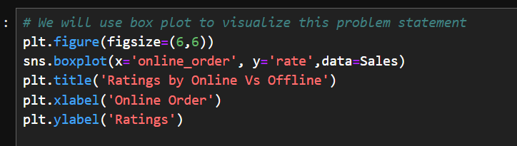
Solution
Conclusion: Offline order received lower rating as compared to Online orders

Slide 18

Problem Statements-6
6. Which type of restaurant received most offline orders. So that Zomato can provide customers with some good offers?

Slide 19
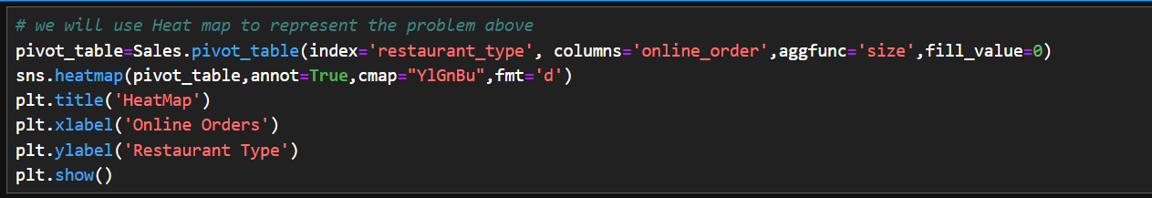
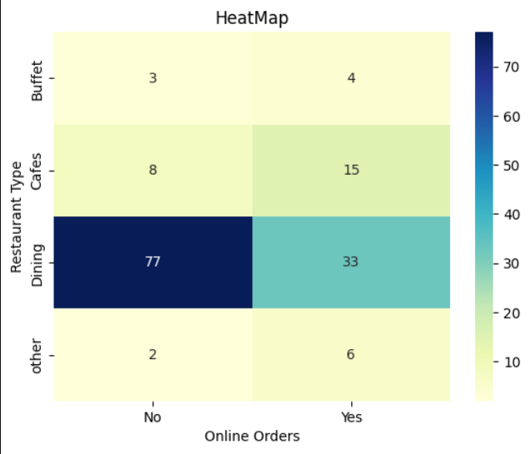
Solution

Slide 20
Project Conclusion
Pandas was used for efficient data handling and manipulation, allowing me to group the data by restaurant type and calculate total votes, helping me understand customer preferences.
NumPy provided the numerical foundation for performing mathematical operations and enhancing data processing speed.
Matplotlib helped me create a variety of static visualizations, such as line charts, making it easier to communicate key insights to stakeholders.
Seaborn added aesthetic value to the visualizations by creating more detailed and visually appealing charts.
These libraries were instrumental in transforming raw data into meaningful insights, allowing me to gain hands-on experience with Python's data analysis ecosystem. The knowledge and skills I gained through this project have significantly enhanced my data analysis abilities, and I look forward to applying them in future endeavors.

Slide 21

Thankyou
I would like to extend my sincere thanks to The iScale YouTube channel for providing invaluable guidance and the free Zomato dataset, which made this project possible. Through their support, I was able to explore the intricacies of data analysis using Python, deepening my understanding of data manipulation, exploration, and visualization techniques.
In this project, I analyzed the Zomato dataset, which includes various restaurant attributes such as restaurant types, votes, and more. By leveraging the powerful Python libraries mentioned earlier, I was able to extract meaningful insights and present them through visually compelling charts and graphs.

